Slide 1

Project Title -Seasonal Agriculture Performance Analysis
Student Name: Amit Rajendra Kushwaha
College Name: Silver Oak University
AICTE STU ID: STU67a830e92f94c1739075817

Slide 2

PROBLEM STATEMENT
Agricultural activities are influenced by seasonal variations in environmental conditions, farming practices, resource availability and market conditions. As a result, agricultural performance may differ from one season to another. However, raw agricultural data does not clearly explain how agricultural performance changes across seasons or what patterns can be observed in different seasonal conditions. The problem is to analyze the given agricultural dataset and investigate seasonal differences in agricultural performance by identifying meaningful patterns, trends, relationships and variations within the available data.

Slide 3
Project Description
This project analyzes a seasonal agriculture performance dataset covering 4,000 farm records across Kharif, Rabi, and Zaid seasons, spanning multiple states, districts, and crops. The dataset includes environmental variables (rainfall, temperature, humidity, soil moisture), resource usage (NPK fertilizer, irrigation, water consumption), and economic indicators (cost, revenue, profit, ROI).
The objective was to identify how agricultural performance varies across seasons and uncover the key drivers behind that variation. The workflow followed a structured data analytics pipeline:

Slide 4
Project Description
Data Cleaning & Feature Engineering — handled missing values and engineered new metrics such as Cost per Hectare, Revenue per Hectare, NPK Total, and a Profitability flag.
Exploratory Data Analysis — compared yield, cost, revenue, and resource usage across the three seasons using visualizations (bar plots, violin plots, correlation heatmaps).
Statistical Testing — ran One-Way ANOVA to confirm whether seasonal differences in ROI, rainfall, and disease/pest risk were statistically significant.
Machine Learning — used a Random Forest Regressor to rank the features most predictive of crop yield.
Insight Synthesis — translated the statistical and ML findings into actionable, evidence-based recommendations for farmers and policymakers.

Slide 5

WHO ARE THE END USERS?
Farmers & Agricultural Cooperatives — to plan crop choice, irrigation, and input usage by season
Government Agricultural Departments / Extension Officers — to design season-specific subsidy and support programs
Agri-input Companies — to time fertilizer, seed, and pesticide distribution to seasonal demand
Agricultural Researchers & Policy Analysts — to study seasonal performance trends for planning
Banks / Crop Insurance Providers — to assess seasonal risk (e.g., disease/pest risk in Kharif) for lending and insurance pricing

Slide 6

Technology Used
Language: Python 3
Data Handling: Pandas, NumPy
Visualization: Matplotlib, Seaborn
Statistical Analysis: SciPy (One-Way ANOVA, Kruskal-Wallis test)
Machine Learning: Scikit-learn (Random Forest Regressor, Label Encoding, Train-Test Split)
Environment: Jupyter Notebook

Slide 7
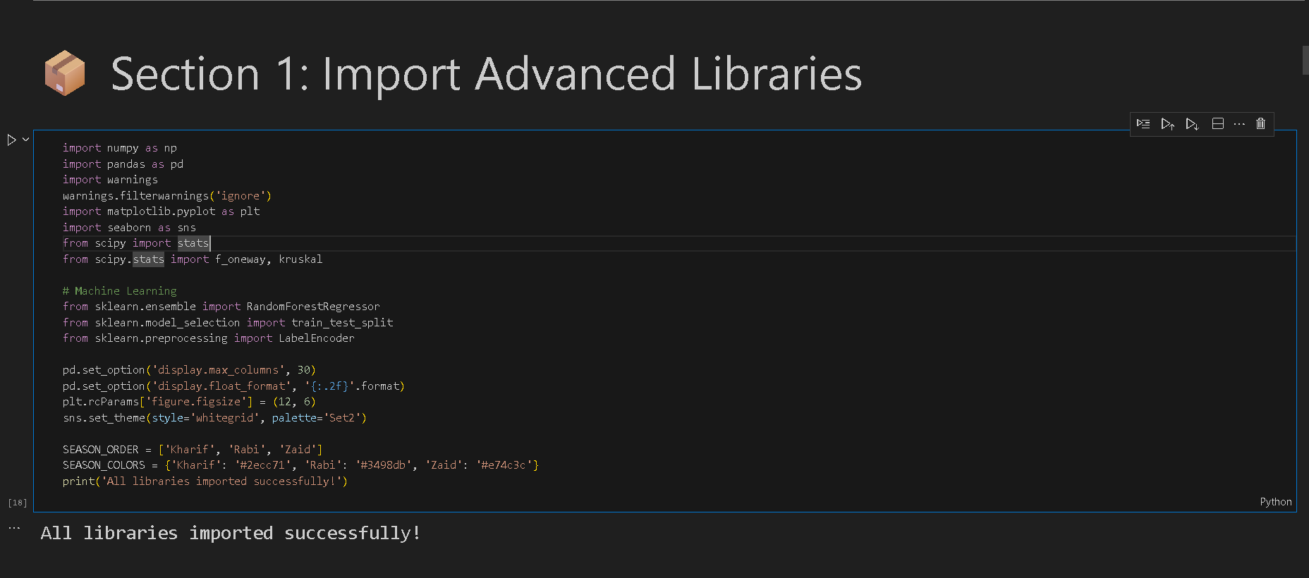
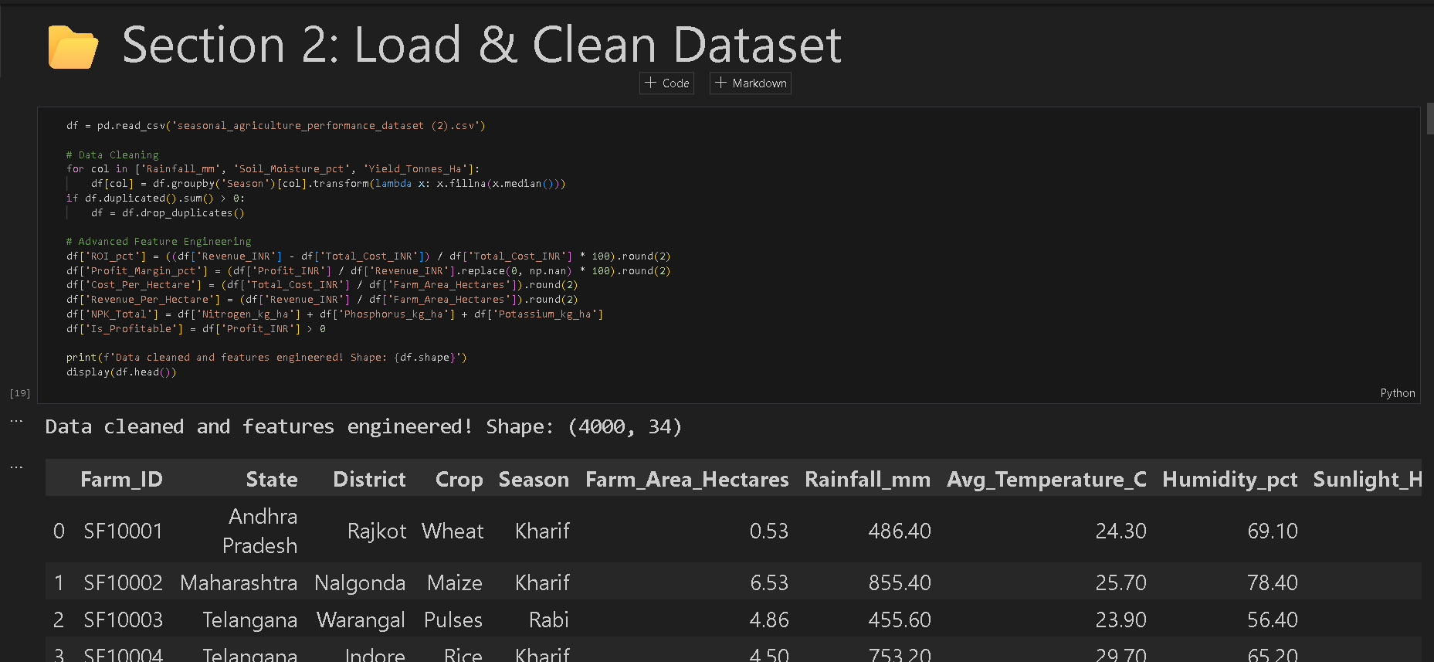
RESULTS :

Slide 8
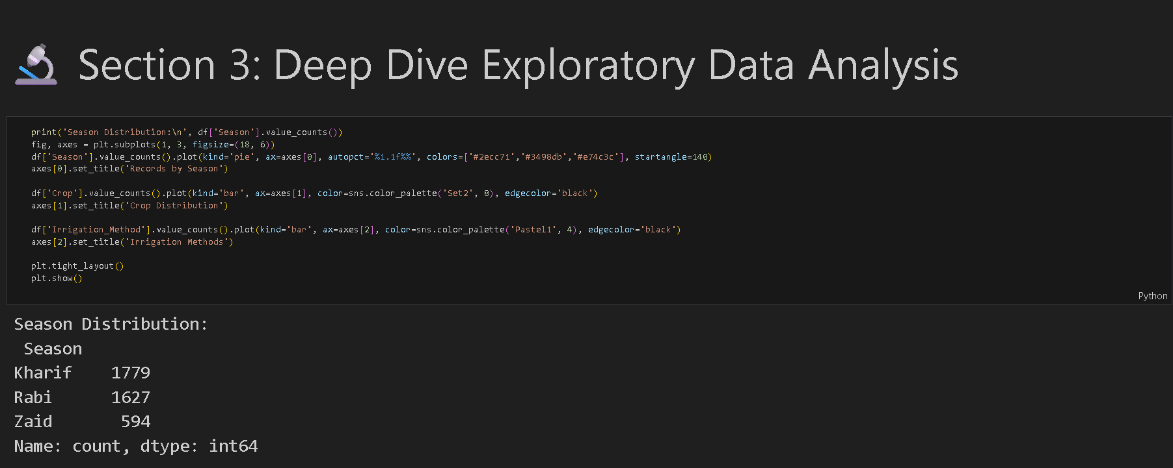
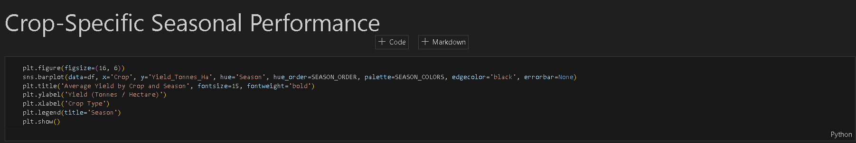
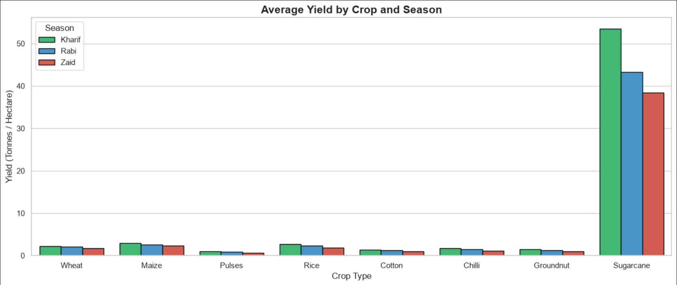
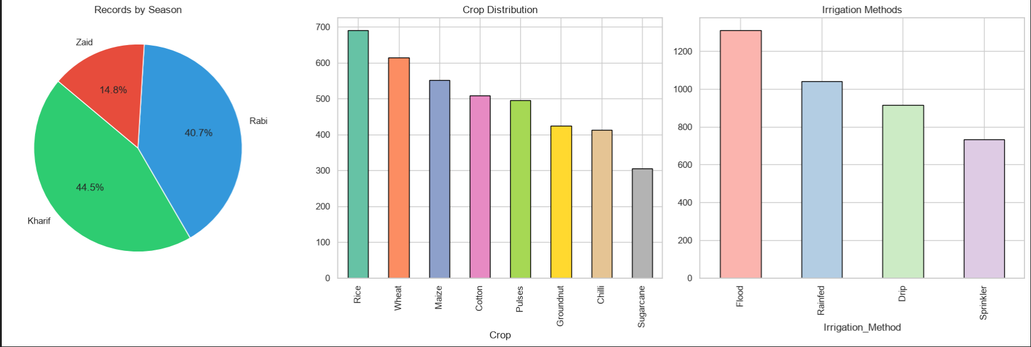

Slide 9
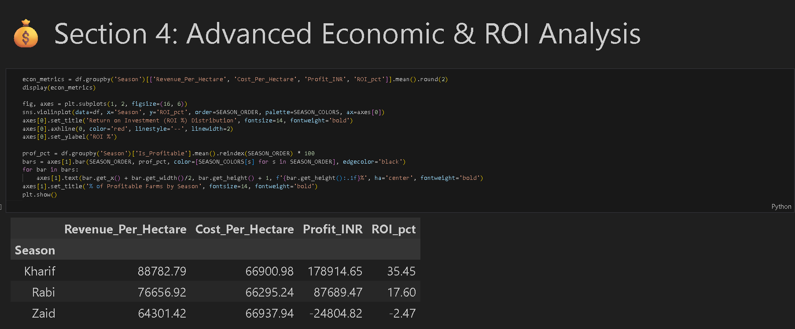
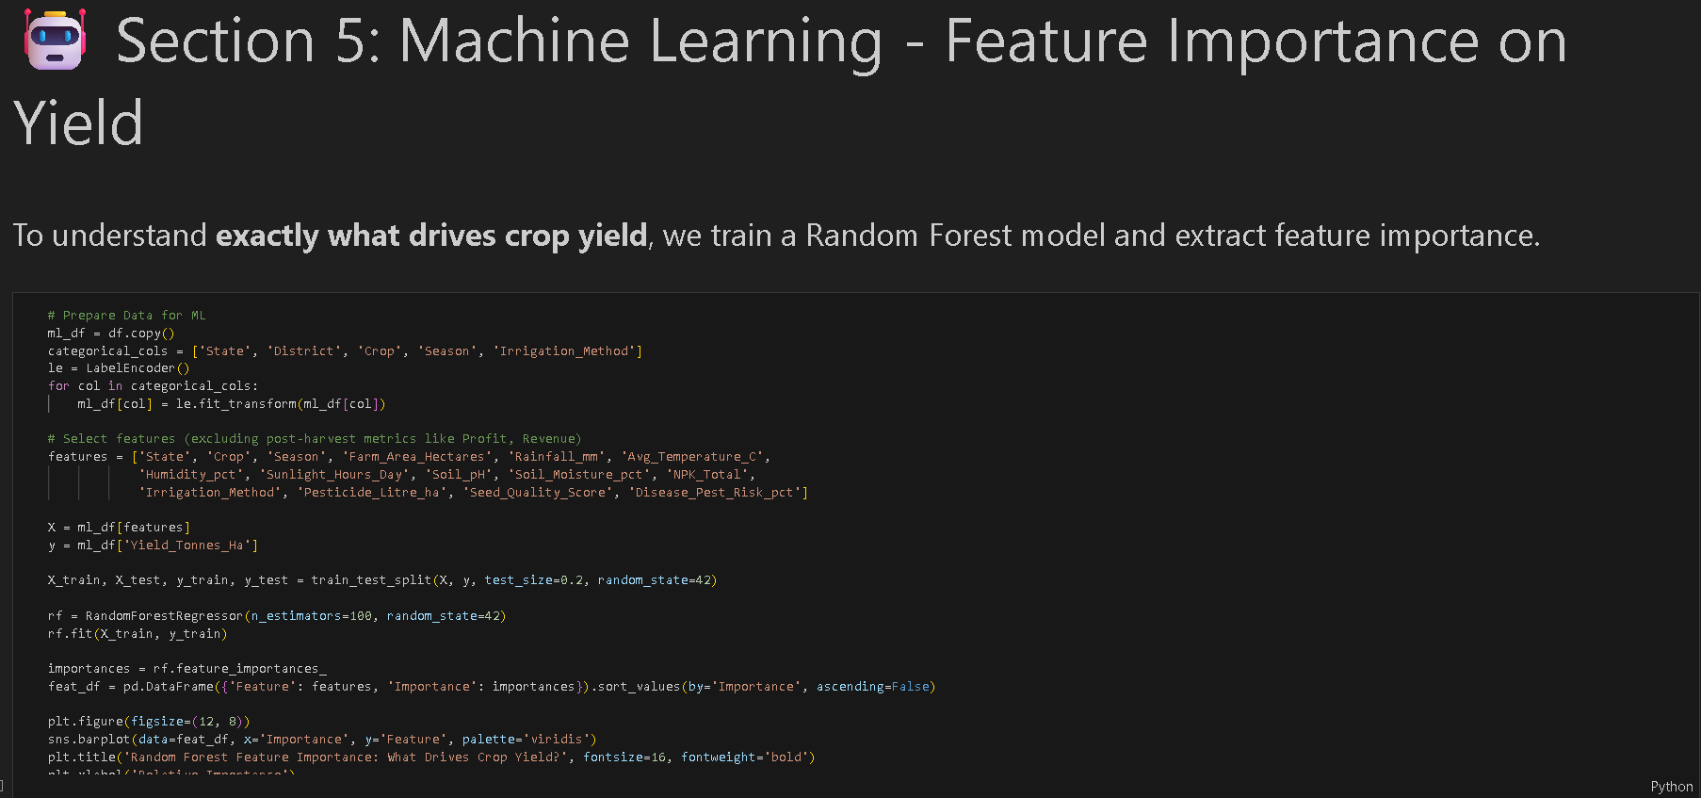
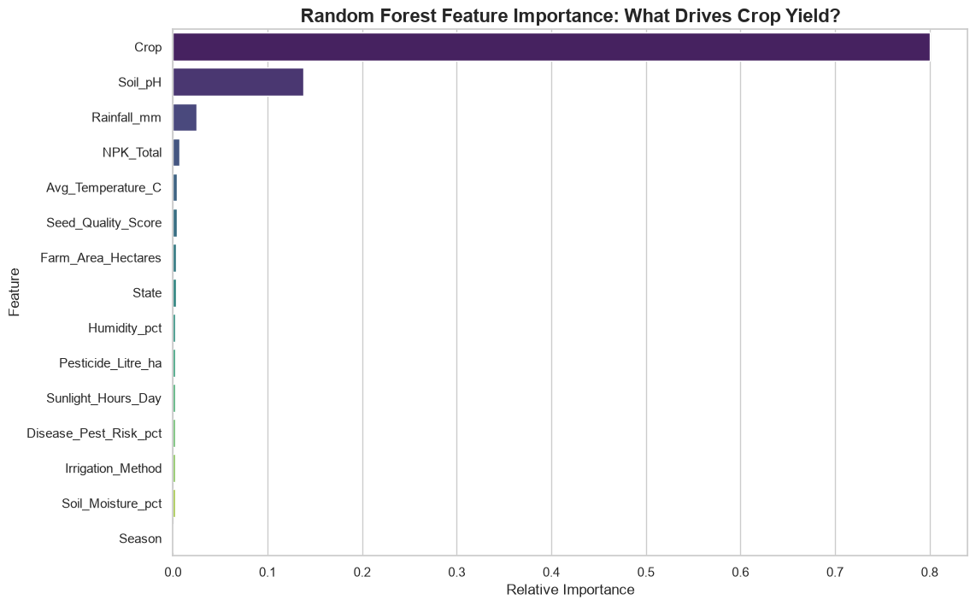
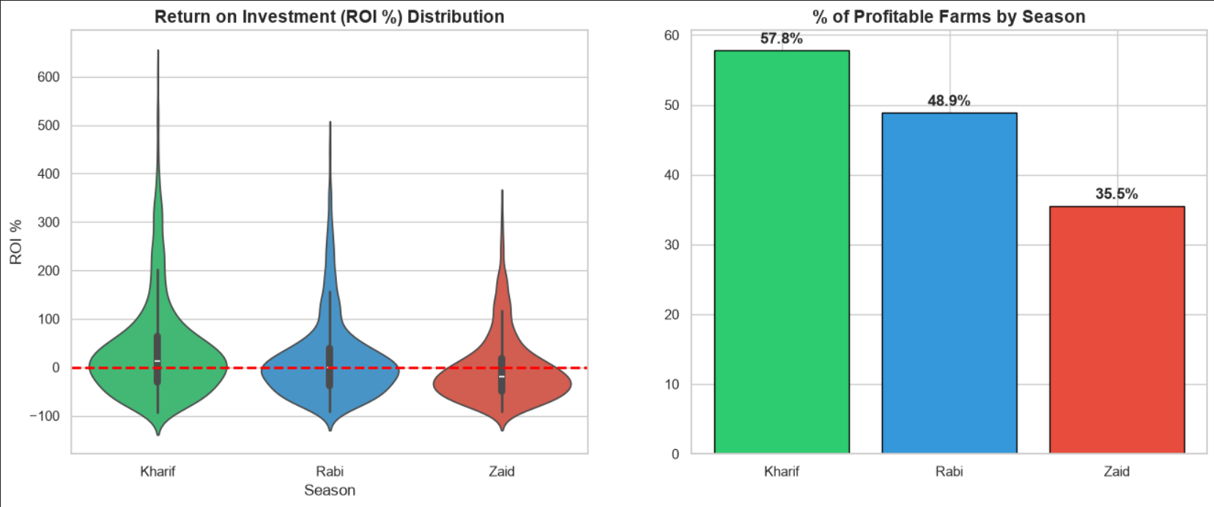

Slide 10
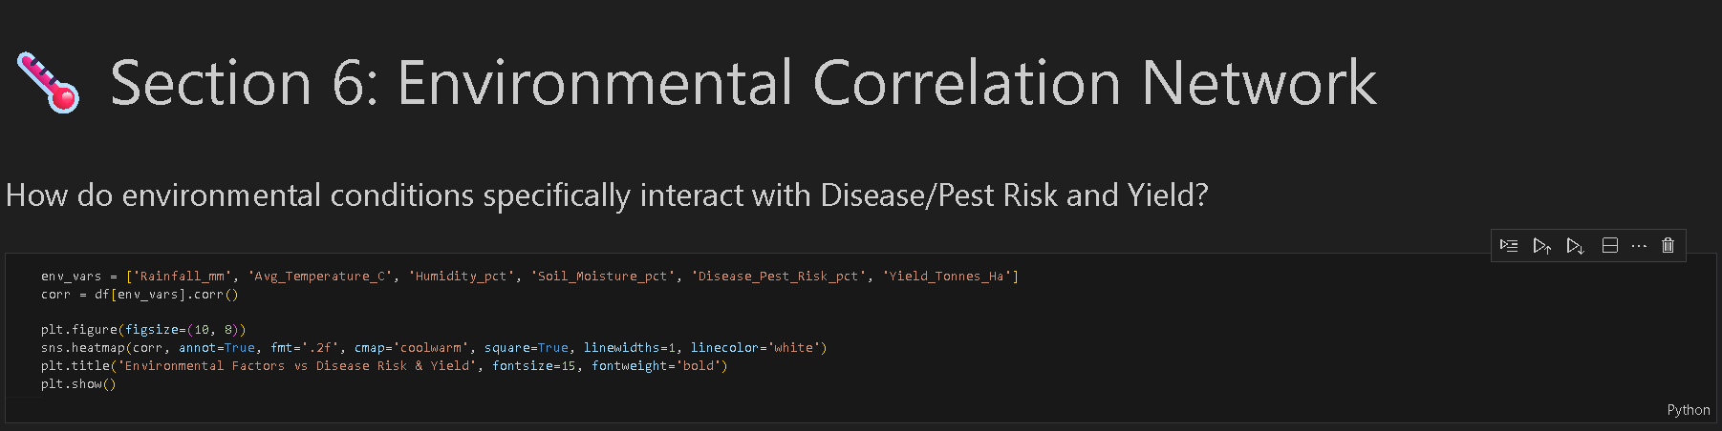
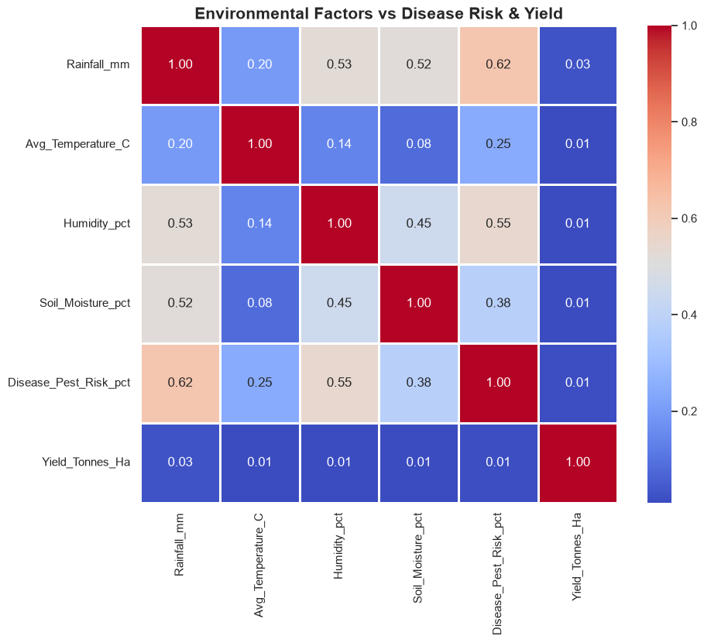
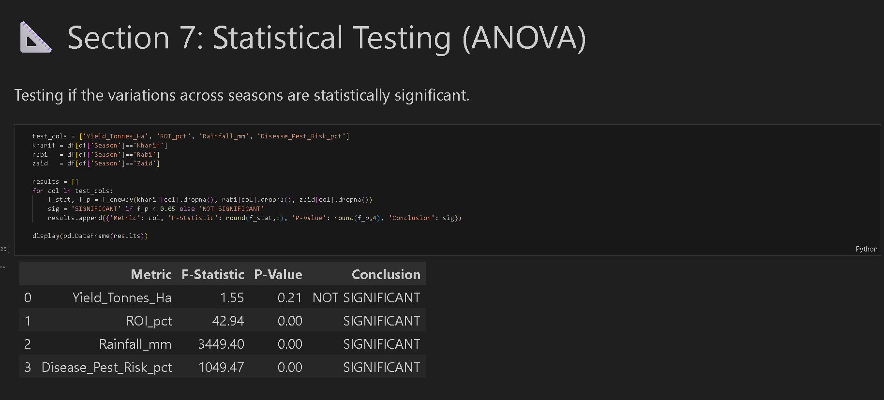

Slide 11
Future scope
Extend the model to a time-series forecasting approach to predict next-season yield and ROI
Incorporate satellite/remote-sensing data (NDVI) for real-time crop health monitoring
Build a district-level dashboard for policymakers to track seasonal performance interactively
Include price-volatility and market-demand data to strengthen economic recommendations
Test additional ML models (XGBoost, Gradient Boosting) and compare accuracy against Random Forest

Slide 12
GitHub Link
github.com/Amitkushwaha328/VOIS-and-Vodafone-Idea-Foundation-s
LinkedIN
https://www.linkedin.com/in/amitkushwaha328/

Slide 13
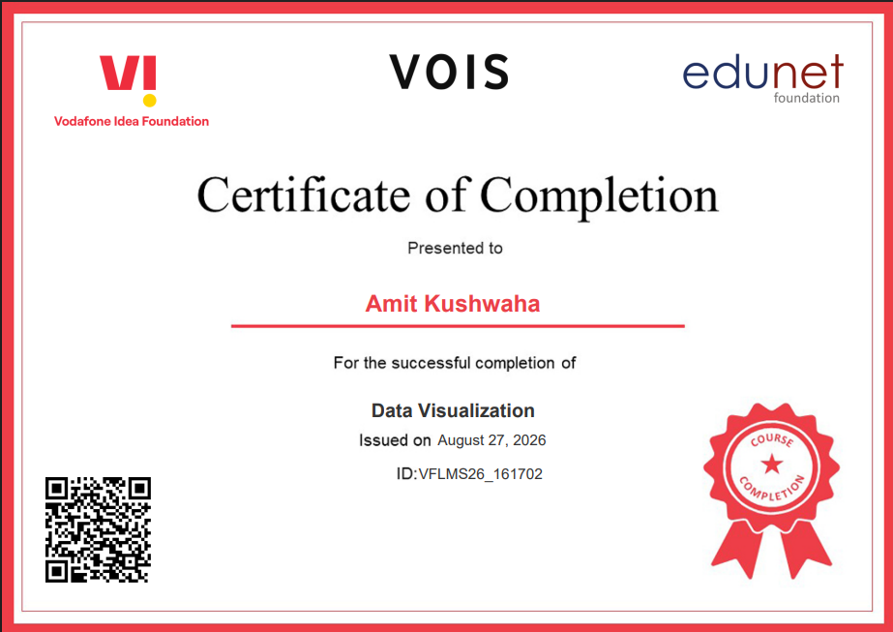
VOIS Course completion certificate - Course name- Data Visualization

Slide 14
Thank you
.
.

